Slide 1
Open Source Software Engineering
SE ZG587
Kumar Manish
11 November, 2023

Slide 2
Session 15 : OSSE – Collaboration and communication tools on GitHub

Slide 3
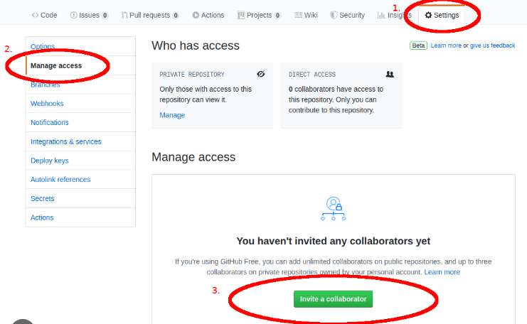
Adding Collaborators to a Github repo
Navigate to the repo to which you want to add collaborators
Click the setting button → and then Manage Button on left side panel
Invite collaborators using the “invite” button

Slide 4
Email Notifications
An email notification mechanism is put in place for communication
The owner of the repo gets a notification through email when a pull request is placed
This email notification consists of the following :
Provides a list and diff of the files that been proposed changed in the Pull request
It also provides a link to navigate to the Pull Request on GitHub

Slide 5
Collaborating on Pull request
GitHub provides collaboration mechanism on Pull request through the conversation page or the discussion page, with the contributors who created the pull request
The Project owner can comment on the entire Pull request or the entire commit or choose specific lines of code and comment ion the same
Other collaborators / contributors may also provide comments on the Pull Request
In this case, the owner of the project will continue to get email notifications about the discussion on the pull request.

Slide 6
Managing Issues
Issues help to keep track of tasks, enhancements and bugs for a Project,
An issue in GitHub consists of the following :
  A title and description which helps to describe additional details about an issue
  Colour coded labels help to categories and filter issue
  A millstone acts like a container for issues. This helps in association issues with specific features or project phases
  Issues can also be mapped to assignees – who would then be responsible for working on the issue at any given time.

Slide 7
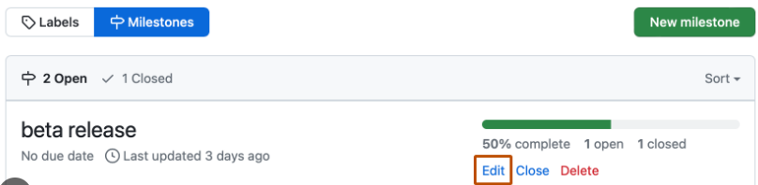

Milestone , Label and Assignees
Milestone, Labels and assignees help in filtering and categorizing issues
Use the “gears“ button on the sidebar on the right in order to add or change labels , assignees and milestones
Labels help to categorize issues in to different categorise
An issue can have multiple labels; can filter issues on these labels - one by one or many labels at a time

Slide 8
Mentions and Notifications
GitHub also provides another notifications system called Mentions - this can be used when you would want to pull in People into discussions and need feedback from them
For this, in a comment , you need to start typing with the “@” character and it will begin to autocomplete with the names and usernames of people who are collaborators or contributors in that project - this is called mentions
On posting a comment with use mention , that user will notified
This notification mechanism proves to be an effective way of involving people into discussion.

Slide 9
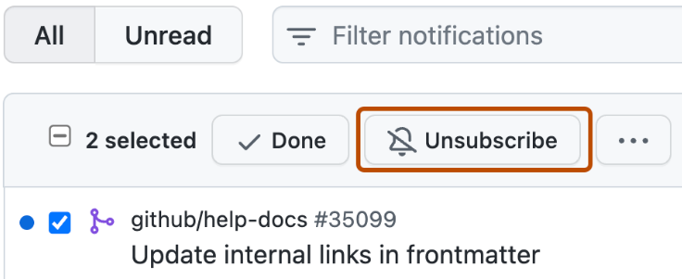
Mentions and Notifications
Whenever a user gets mentioned on a issue or pull request , he / she gets be “subscribed” to it and will start to get all related notifications.
Moreover, by default , a contributors is be subscribed to something that he / she opened , or is watching a repository or comments on something
In order to stop receiving notification, use the “unsubscribe “ button

Slide 10
Watching a repo
You can start watching a repo by simply navigating to that repo from your login and click on the watch icon on the extreme right corner, close to fork button
If you are watching a repository , you will receive notification for all conversations – project issue, pull requests comments on commit and any other comments.
In case you have push access to a repository -GitHub automatically adds it to your watch list – this is an auto watch features

Slide 11
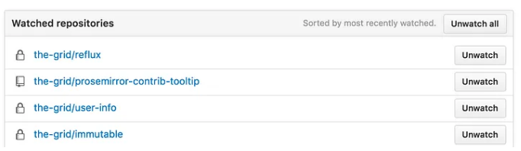
Un-watching a repo
To unwatch a repo, navigate to notification settings → List of all watch repo and selectively unwatch them
By default all are in watch list

Slide 12
Star / un-star a repo
You can star a repo by simply navigating to that repo from your login and click on the star icon on the extreme right corner , next to fork button
When you start a project you can keep track of it, but you won’t be notified of every change
In order to star repo , use the star button next to the watch button on the home page of every repository

Slide 13
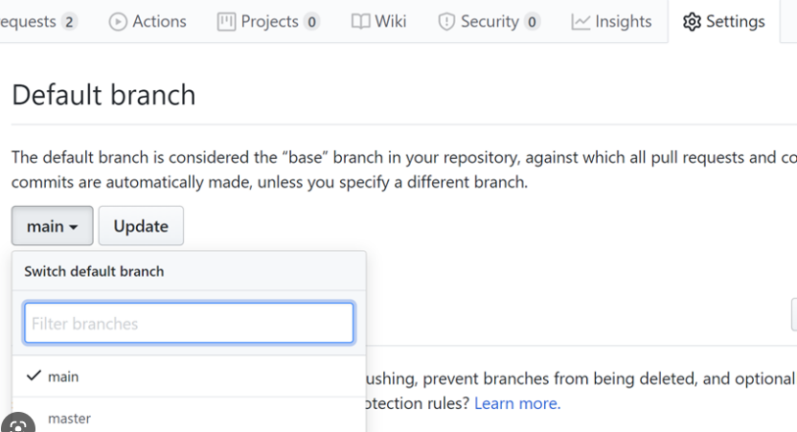
Project Administration :
Changing the default branch
If you are willing to use a branch other than the “master” as your default branch,
and want that people should open Pull request on it or see it as default,
Then, navigate to the repository’s setting page under the Branches “ tab and change the branch

Slide 14
Changing visibility of a repo
Navigate to “Settings” --> Option → Danger zone → change visibility
Making a repo Private :
GitHub will detach public forks of the public repository
Changing a repository’s visibility from internal to private will remove forks that belongs to any user without access to the newly private repository
Any published GitHub Pages site will be automatically unpublished
Making a repo public :
GitHub will detach all private forks and turn them in to a standalone private repository.

Slide 15
Transfer a project
In order to transfer a project to another user or an organisation in GitHub, use the Transfer ownership “ option at the bottom of the “Options“ tab of your repository settings.
This is helpful in case a project is to be abandoned ad some one else wants to take over ,
Or if the project is getting and you want to move it into an organisation,
This will move the repository along with all its watches and star to another place
It will also sets up a redirect from your URL to the new place

Slide 16
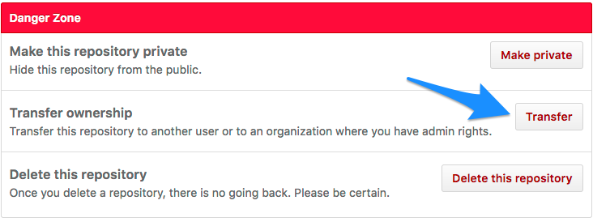
Transfer a project

Slide 17
Archive a repo
You can archive a repository to make it read – only for all users and indicate that it’s no longer actively maintained.
You can also unarchive repositories that have been archived.
It is recommend that you close all issues and pull request , as well as update the README file and description , before you archive a repository.
Navigate to settings --? Option→ Danger zone → Archive this repo

Slide 18
Delete a repo
Only members with owner privileges for an organisation or admin privileges for a repository can delete an organisation repository
Deleting a public repository will not delete any forks of the repository.
Navigate to settings → Option → Danger zone :

Slide 19
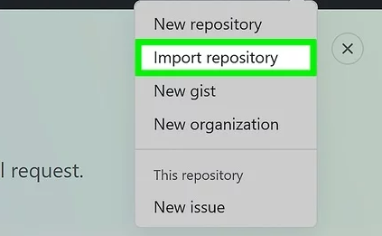
Import a repo in GitHub
If you have a public project hosted on another version control system, you can automatically import it to GitHub using GitHub Import tool.
You will be prompted to enter the URL of the old repo
This is followed by the steps which are same when you create a new repo in GitHub

Slide 20
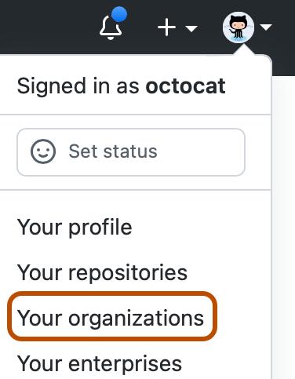
Managing an Organization
GitHub also provides the option to create organisation , with shared ownership of project repositories
For creating a new Organisation, click on the “+” icon on the top right corner of your GitHub page and select “New organisation”
Give an appropriate name to your Organisation and an email id.
Now invite co-owners to the account

Slide 21
Creating Teams
You may also divide people belonging to your organisation in to teams.
For e.g. – you may have teams like - front end developers team, bak end team etc
Create repository with in a team and assign members to it

Slide 22
Understanding Markdown language
Markdown is a way to style text on the web
In GitHub , markdown is primarily used in:
  Writing comments in Pull request and issues
  Readme file or contributors files
  Files with .md or .markdown extension
It helps to :
  Modify the display of the document
  Formatting text – as bold or italic
  Adding images, hyperlinks
  creating bulleted lists , numbered lists etc

Slide 23
Understanding Markdown : Text formatting
It is just regular text with a few non –alphabetic characters , like # or “
Use “word” or _word_to make a word bold
Use “word” or _word_to make a word italics
Link to website :
[link to google](http://google.com)
Header
  Use # to indicate the heading level
    For example :
    # This is heading1
    ## This is heading2
    ### This is heading3
    #### This is heading 4

Slide 24
Understanding Markdown : Listing
Use : for creating a bulleted list
For example :
This can be used to create bullet points :
      Point1
      Point2
Use simple numbering for creating an order list.
For example : This can be used to create ordered list :
  1. Point 1
  2. Point 2
  3. Point 3

Slide 25
Markdown editors
StackEdit – In-browser Markdown editor
https://dillinger.io/
https://pandao.github.io/editor.md/en.html

Slide 26
What are GitHub Pages
GitHub Pages is a static site hosting service
They are commonly used to host a website about your project, or your organisation or even about yourself – directly from a repository on GitHub.com
It makes use of
HTML
CSS and
JavaScript

Slide 27
Working with GitHub pages
Navigate to GitHub.com
Create an account – it is linked to your email id
Example - username is kmbits
Create a repository in your login with the same name as your username - kmbits.github.io
You may NOT choose any license for the same
Create a file index.html
Use HTML to write content – create profile page
View your profile : https://kmbits.github.io/

